Slide 1

Detection of road networks in a mid-resolution satellite image
B.Tech Project Presentation
CE495
Nautatava Navlakha (160040007)
Supervisor: Prof. Gopal Patil
Department of Civil Engineering
IIT Bombay

Slide 2
Outline of the Presentation
1
Road detection
2
Convolutional Neural Networks
3
Motivation and hypothesis
Super resolution
4
Elucidating the mechanism
Our observation
Conclusions
5
6
7

Slide 3
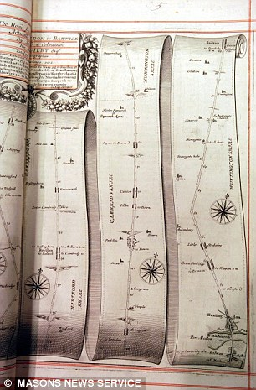
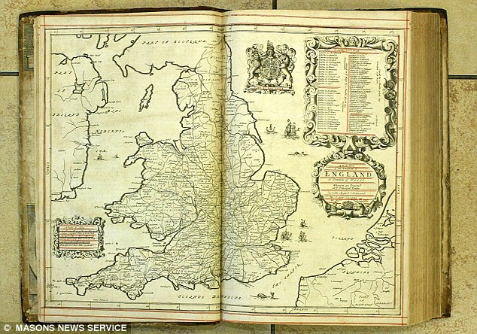
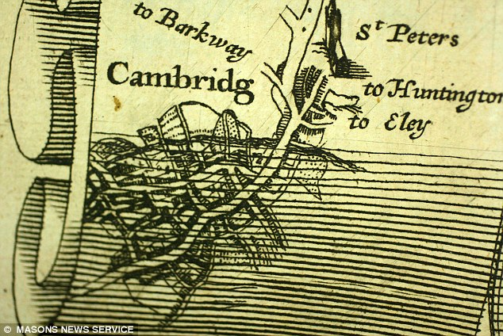
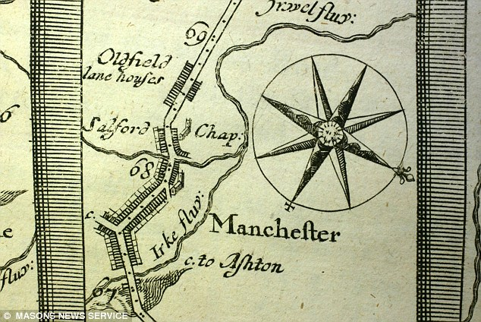
A brief history
Earlier maps plotted only for areas of spiritual significance or routes to markets.
Transition from paper to digital medium: moving from hand-based mappings to automated maps.
Motivation:
Transition from manual work to automated work.
Faster output.
Capital efficient.
Some of the first road maps in England. http://forums.canadiancontent.net/showthread.php?t=87528
Notes:
One of the first road maps in human history. These maps were hand made and were very expensive to maintain. Distances were calculated based on trigonometric angles and approximate measures. Most of these maps only covered important routes, like religious places, or financial and industrial hubs. These maps were rare and expensive. With industrial revolution, maps began to be printed, thus becoming cheaper and affordable. This was the first step towards automation.

Slide 4
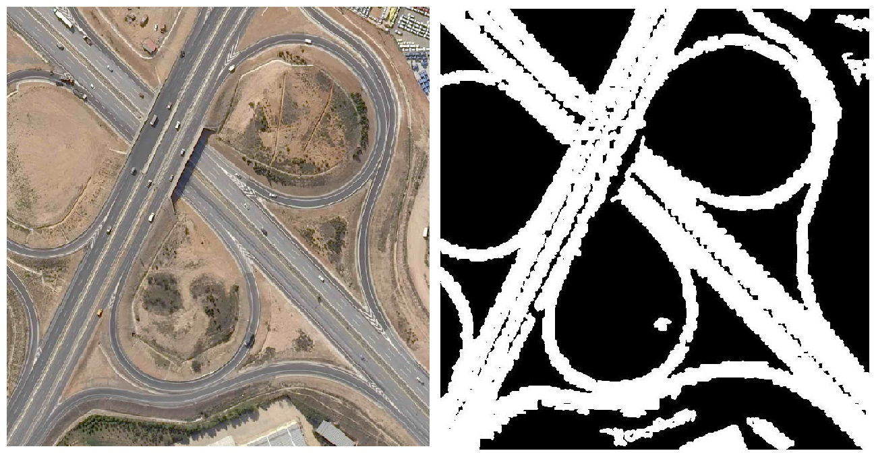
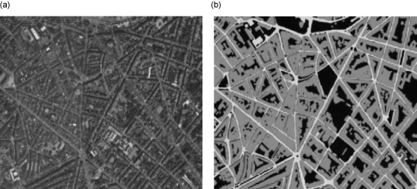
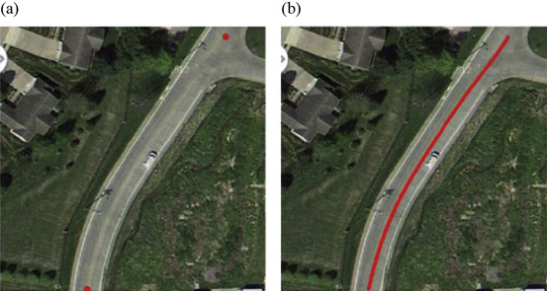
Road detection: Approaching automation
Identifying road networks based on color https://www.mathworks.com/matlabcentral/fileexchange/56234-color-invariant-features-for-object-road-detection
Identifying road networks using SVM based algorithms. https://www.sciencedirect.com/science/article/pii/S2095756416301076#fig4
Road detection by a semi-automatic method with different seed points and Miao algorithm. https://www.sciencedirect.com/science/article/pii/S2095756416301076#fig6
Notes:
Other than the simple algorithms depicted, road detection can also be done using fuzzy logics. (Fuzzy logics deal with probabilities rather than definite outcome)

Slide 5
Convolutional Neural Networks (CNN)
Made up of several convolutional block.
Different types of layers:
Input layer
Convolution layer
Pooling layer (Max pooling, min pooling, mean pooling..)
Fully connected layer
Different variants of a convolution block:
Strided convolution
Dilated Convolution

Slide 6
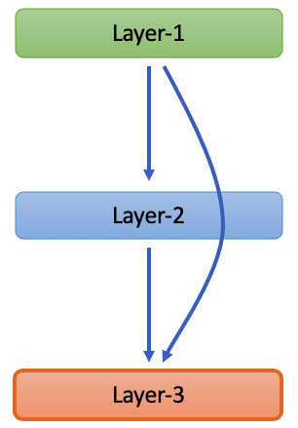
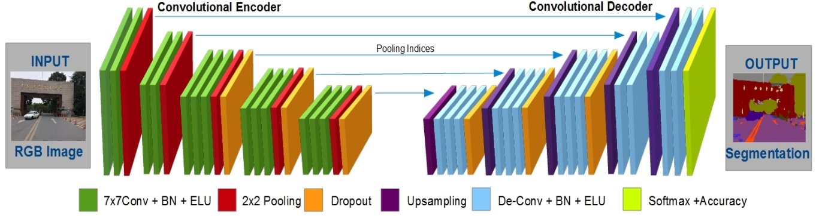
CNN Architectures
The way in which the layers are structured and the elements used in each layer determine the architecture of a CNN.
Some architectures: ResNet architecture, encoder-decoders.
Skip connection
ResNet architecture
Encoder-decoders
Image adapted from An encoder-decoder based convolution neural network (CNN) for future advanced driver assistance system (ADAS)
Notes:
ResNet: Change In Weighti ∝ ∂ (Error Function) / ∂ (weighti)

Slide 7
Motivation and hypothesis
Width of roads on a mid-resolution satellite: usually from 1-3 pixels.
Applying road detection algorithms usually skips out the narrow roads.
Road pixel not detected for 1 pixel wide roads?
Individual pixel-based road-detection algorithm able to identify a road 4 pixel wide.
Hypothesis: “not able to determine an edge in 1 pixel.”
What if we break every pixel into 4 pixels, then apply edge/road detection algorithms?
Hypothesis: "Should enhance the road-finding capacity of road-detection model.”
The breaking of every pixel into more pixels is done by super-resolution. Hence the aim of the work is to use SR before applying road-detection.

Slide 8
Super resolution
Process of upscaling an image.
Enhances the resolution of digital imaging sensors.
Multiple SR algorithms used with different use-cases. Here, need to focus on maximizing signal-to-noise ratio.
Examples of Super-resolution algorithms:
Decrappify
Deep Back-Projection Networks (DBPN)
Enhanced Deep Super-Resolution network (EDSR)
Wide Activation for Efficient and Accurate Image Super-Resolution (WDSR)
Very Deep Super-Resolution network (VDSR)
Notes:
DBPN has a unique error feedback. error feedback (EF) is usedto guide the reconstruction in the early layer. Here, weanalyze how error feedback can help for better reconstruc-tion. For the scenario without EF, we replace up- and down-projection unit with single up- and down-sampling (decon-volution and convolution) layer.

Slide 9
Elucidating the mechanism
Image
Super-resolution model
Road-detection model
Road-Network
Input
Model
Output
Notes:
Explain the models. Modified resnet coz low-level operation.

Slide 10
Elucidating the mechanism
Image
Super-resolution model
EDSR
Road-detection model
D-Linknet
Road-Network
Input
Model
Output
We are using EDSR for super-resolution model.
We will be using D-Linknet for road-detection model.
Notes:
Explain the models. Modified resnet coz low-level operation.

Slide 11
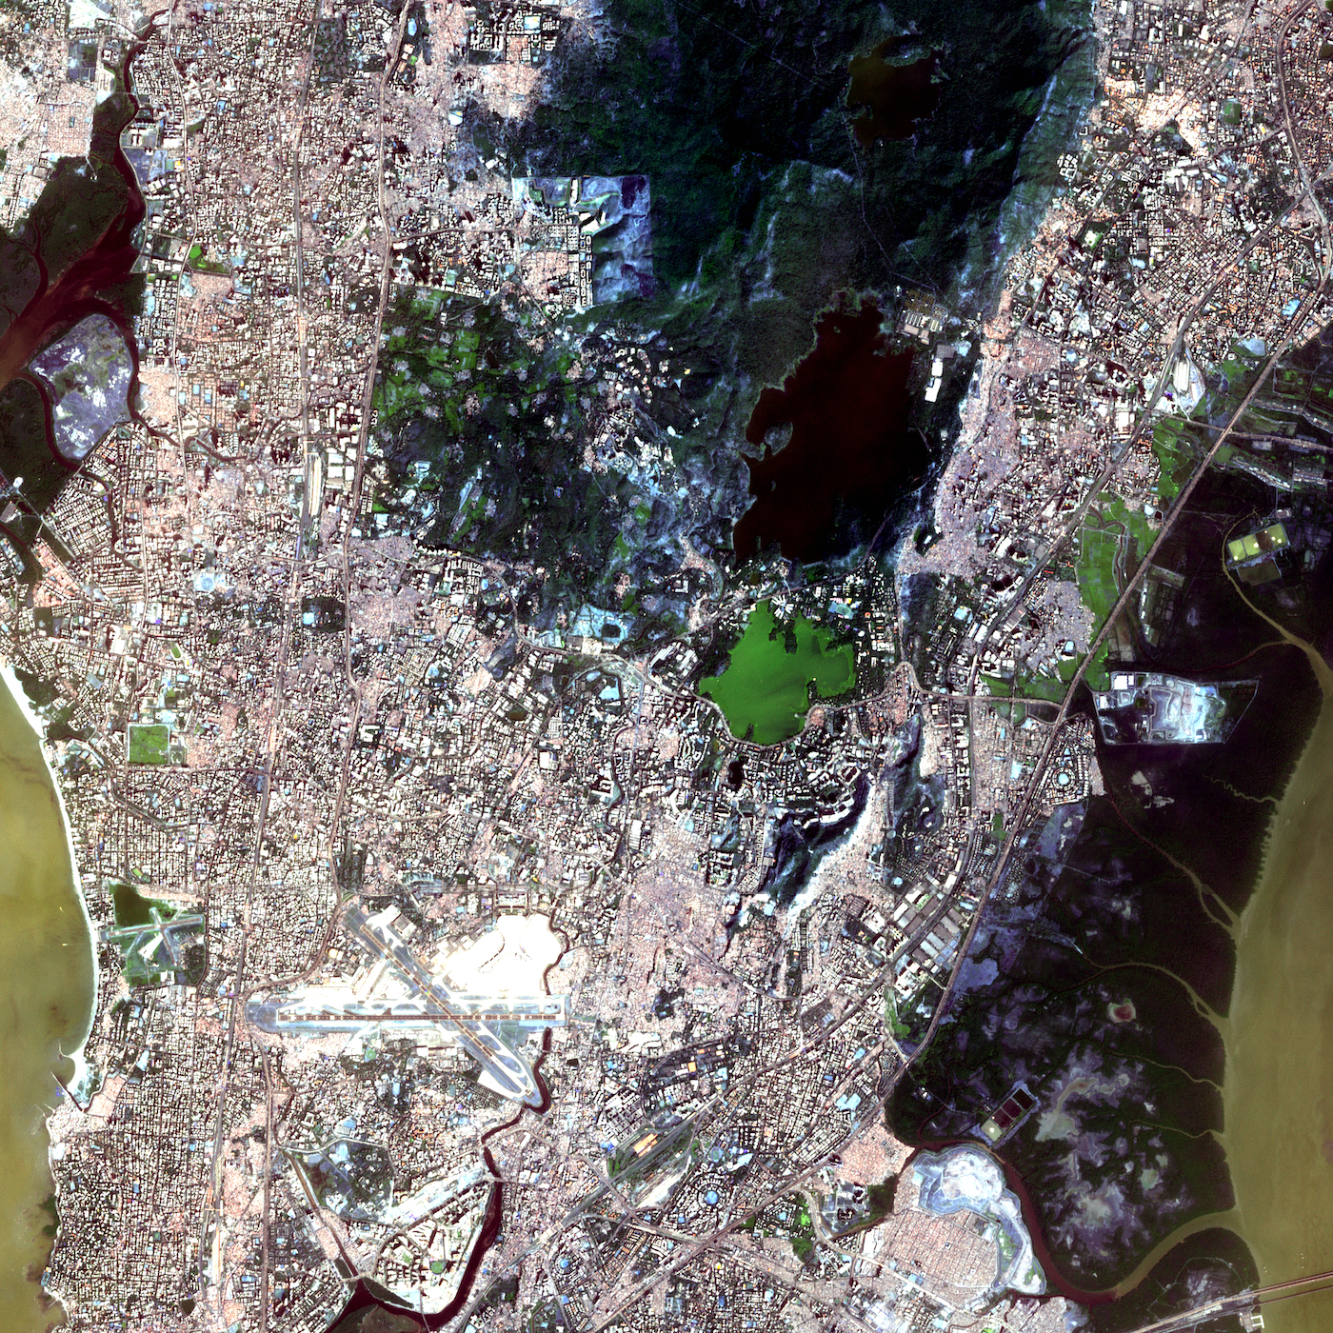
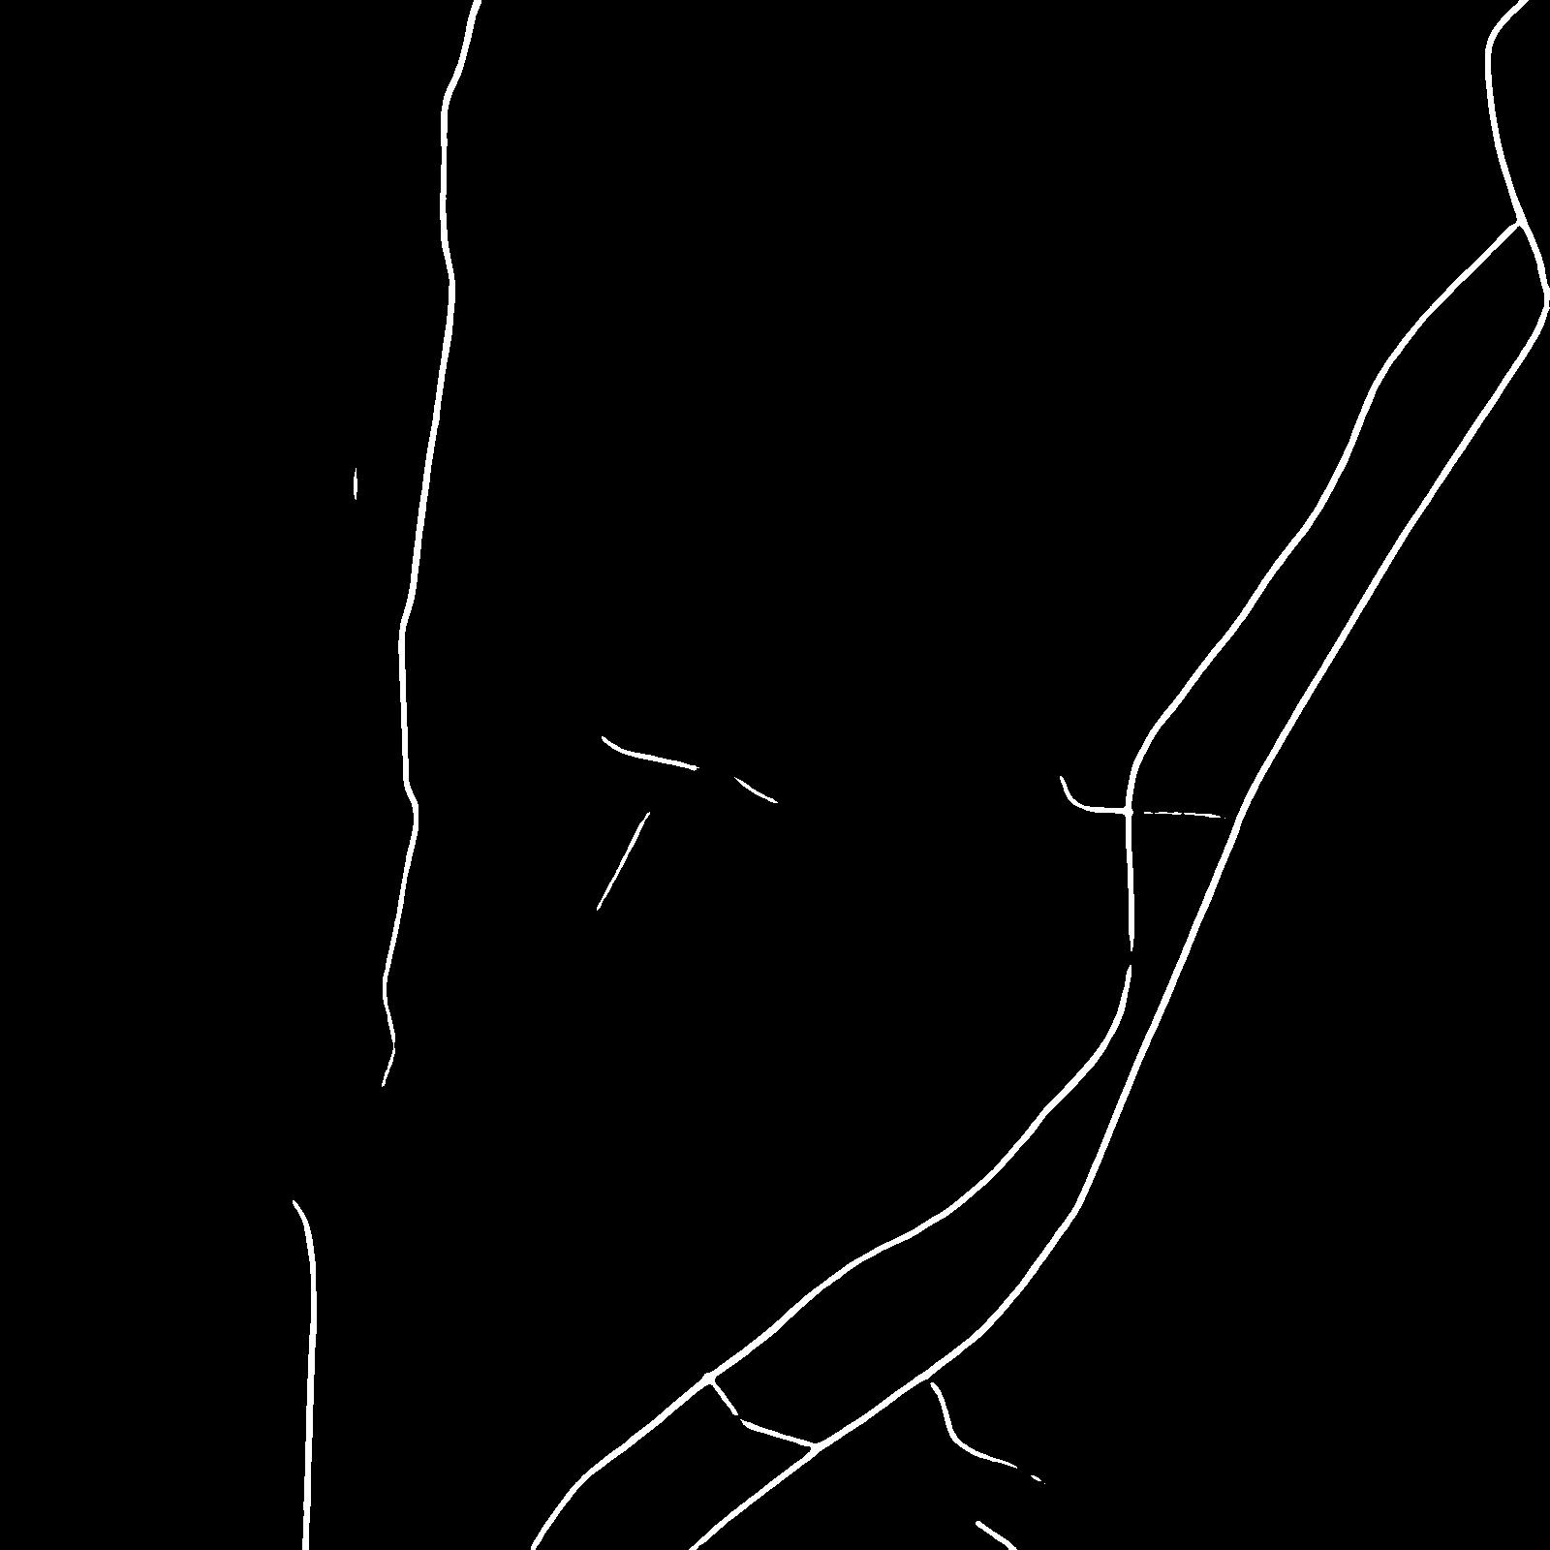
Our Observations
The satellite image
Directly applying road-detection
Applying super-resolution before road-detection
Notice how dense our predicted road map is!

Slide 12
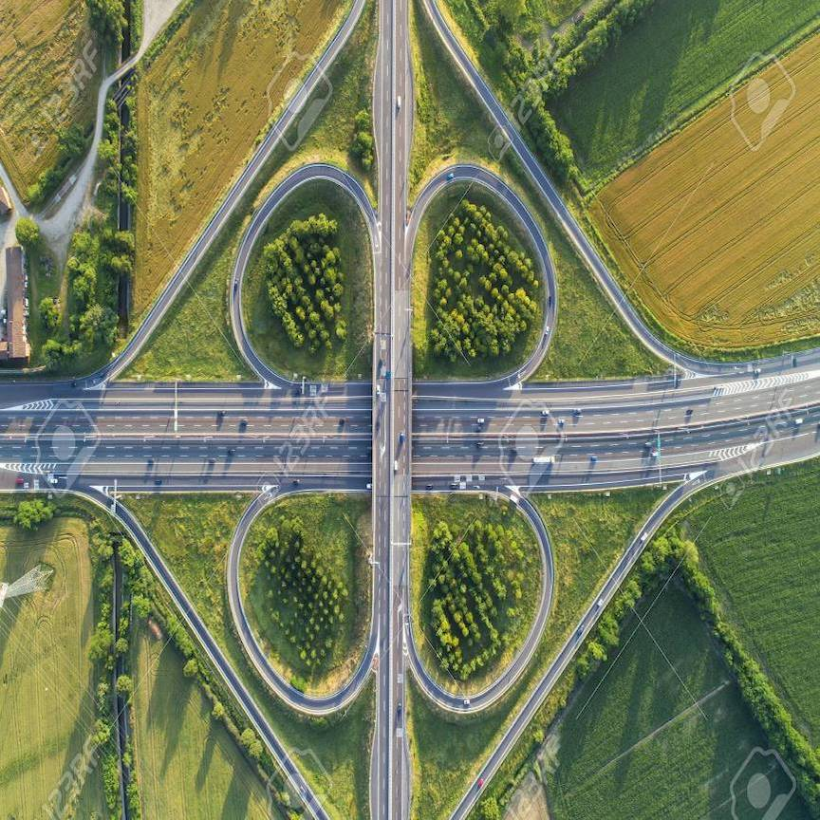

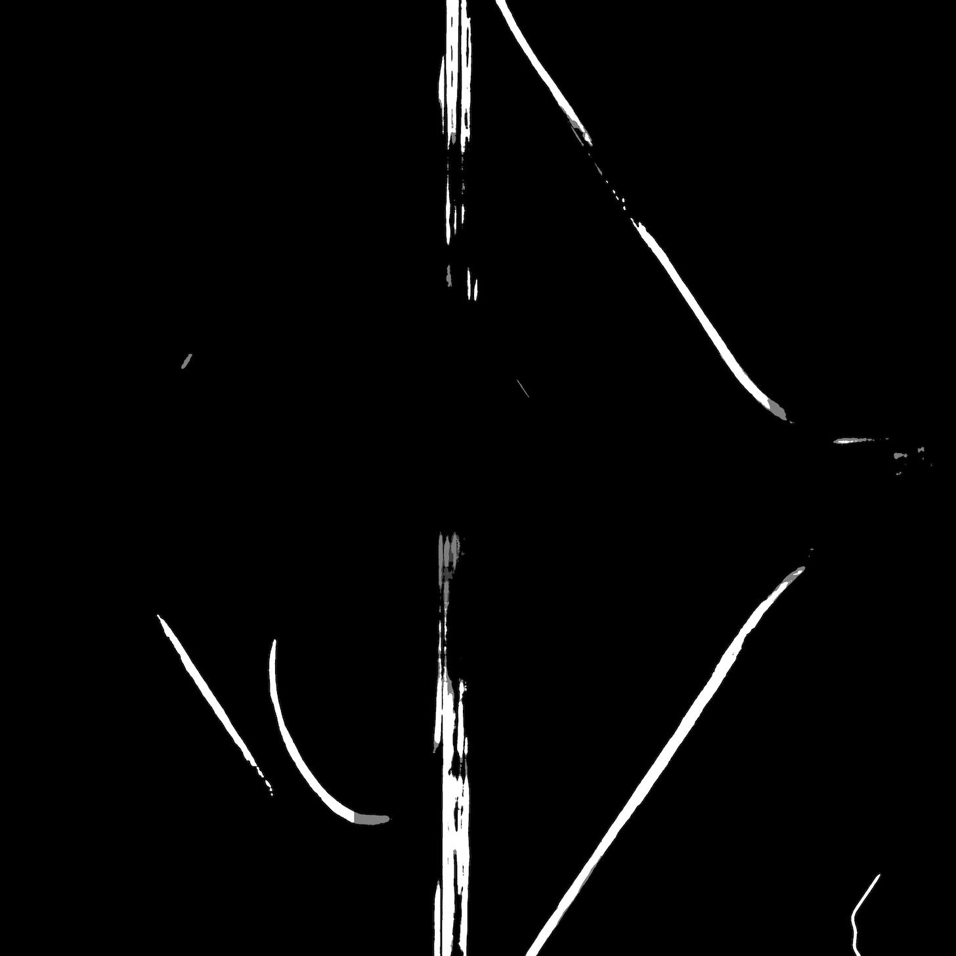
Our Observations
Aerial view
Road Network detected without super-resolution
Road Network detected using our model
This is what happens when model is applied to where it should not be.
Notes:
As much as this method looks plausible, it is to be taken care for the model not to be applied on very wide roads.

Slide 13
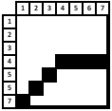
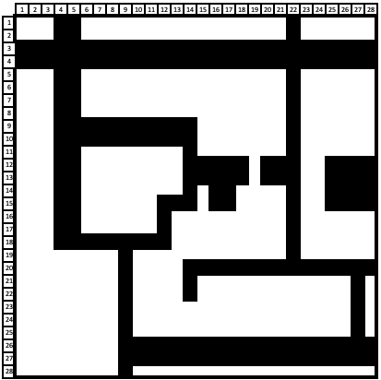
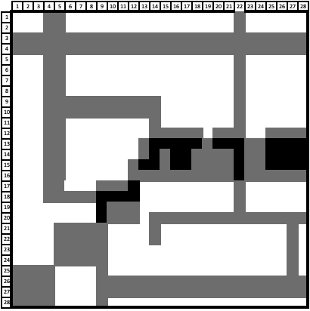
Our Observations
Conventional Road detection (without SR)
Road detection with SR
Road detection: fuzzy logic
Using the goodness of both conventional and SR models to create a probability (fuzzy) map.

Slide 14
Conclusions
Narrow roads that were not recognized by the road-detection model are now visible in the predictions.
Spatial connectivity of broad roads is the cost we pay for the improved prediction.
We can use average out the results of various models to get a fuzzy-algorithm type output to take the best of narrow and broad roads together.
Notes:
As much as this method looks plausible, it is to be taken care for the model not to be applied on very wide roads.

Slide 15
Some unanswered questions based on my work
Small amounts of discontinuities seen when using super-resolution before road-detection.
Discontinuities due to the fact that noise is an inherent part of super-resolution?
Any other reason for the discontinuity?
Both road-detection and super-resolution are performed using CNNs. Models are individually trained and together used for prediction. Result is that we get good predictions of narrow road-networks.
Given that both are CNNs, why are not all roads are identified in the first place?
Why isn’t super-resolution an inherent part of road-detection?
Can we make a model combining the power of both SR and road-detection?

Slide 16
Thank You

Slide 17
Supplementary material

Slide 18
Convolution
Go back
1
1
0
1
0
1
0
1
3
3
3
0
0
1
0
1
(Filter)
(Output matrix)
1
0
1
3
2
3
1
1
Input
0
0
1
1
0
1
2
3
2
1
0
0
1
0
Finding the value of output from a filter
ai,j = f( ∑ ∑Wm,nXm+i,n+j)
0
1
0
0
1
Notes:
In pooling layer, we find the eigen values.
For strided convolution, we move by more length instead of 1(here).
For dilated convolution, we spread out!

Slide 19
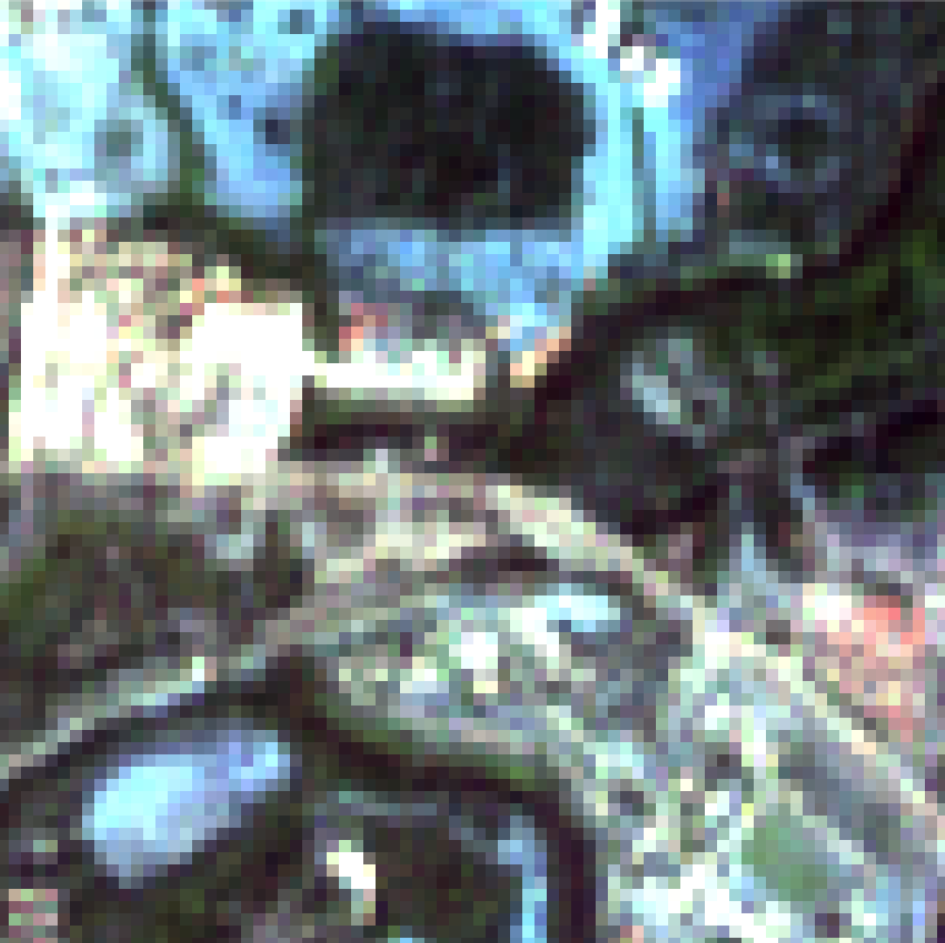
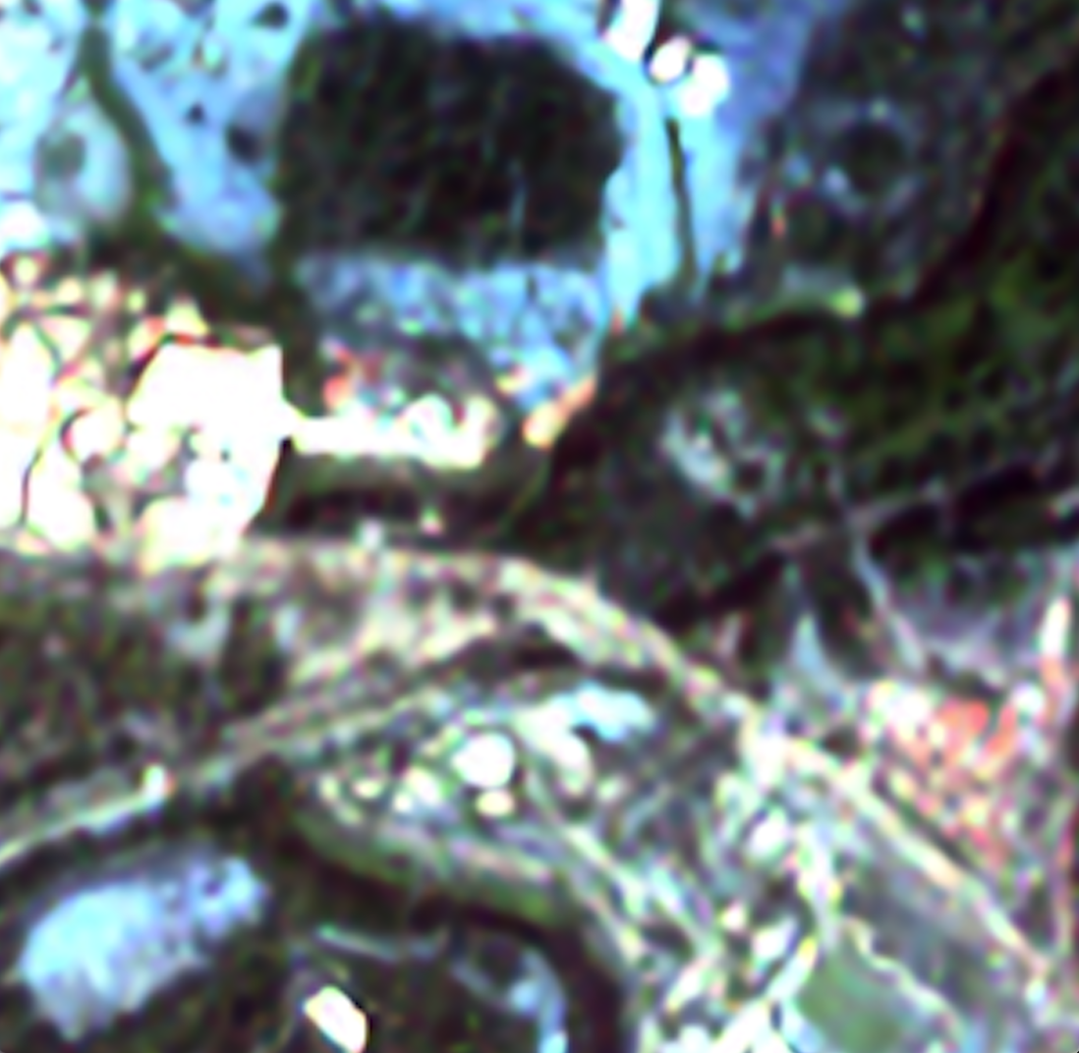
Super-resolution model
Original image
EDSR
x_{i}
Conv
x_{i}
Modified Residual Block
Conv
Conv
Upsample (4x)
Shuffle
Modified Residual Block
Modified Residual Block
ReLU
Conv
Conv
Conv
Shuffle
x_{i+1}
Upsample (4x)
Conv
x_{i+1}
Conv
Convolution block 3*3
Final image
Go back

Slide 20
Original image
Road detection model
Roads in an image
D-Linknet
Conv (7*7, stride =2)
Conv (3*3, dilation = 1)
Max Pooling
4*4 Transposed Convolution
3*Residual Block
Decoder Block
Max Pooling
Decoder Block
4*Residual Block
Max Pooling
Decoder Block
6*Residual Block
Max Pooling
Decoder Block
3*Residual Block
Conv (3*3, dilation = 1)
Conv (3*3, dilation = 2)
Conv (3*3, dilation = 4)
Conv (3*3, dilation = 8)
Go back
ResNet34 encoder
Enlarge the receptive Field
ResNet34 decoder

Slide 21
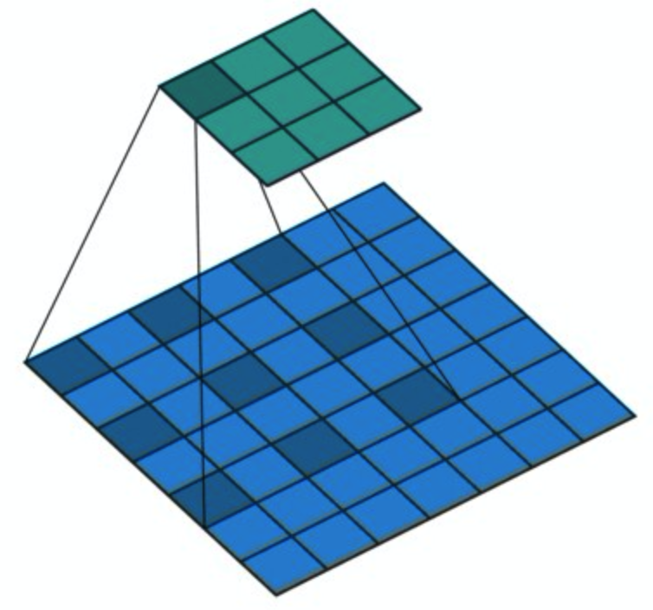
Dilated convolution

